Slide 1
Deep learning in drug discovery: Computational chemistry application
Summer 2024 Workshop

Slide 2
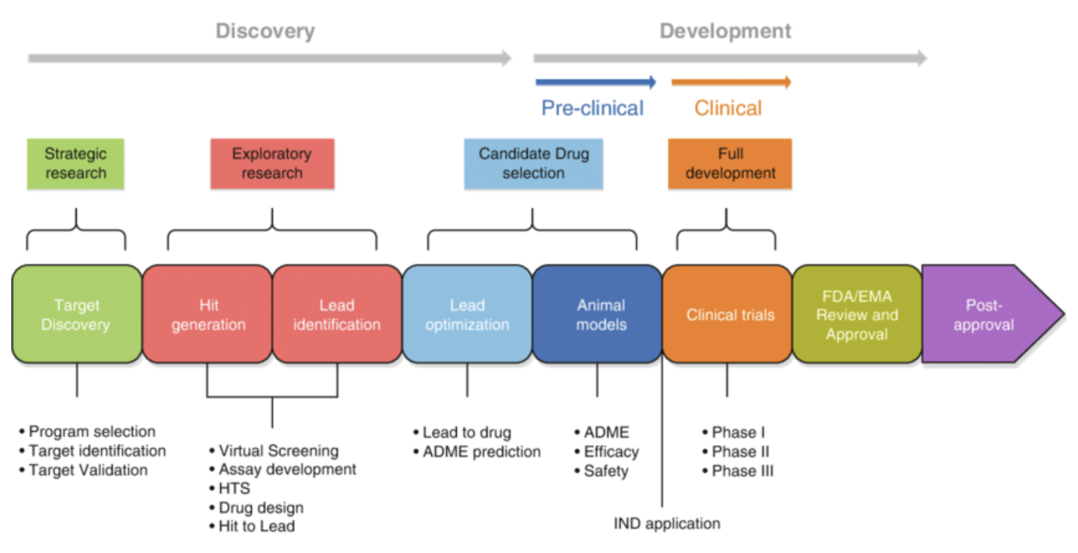
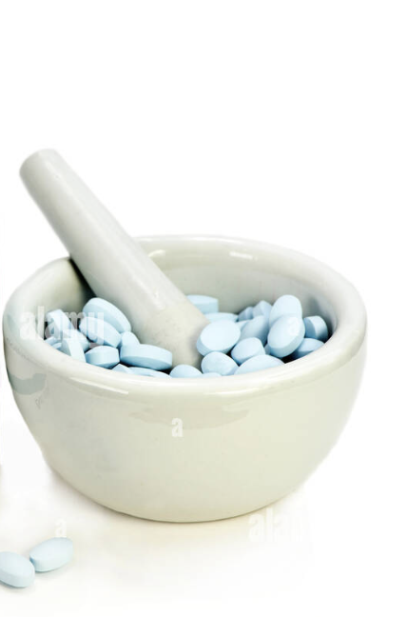
Drug Discovery

Slide 3
Outline of the workshop
Introduction to drug discovery (computer-aided drug design, CADD)
General idea about the tools for CADD
Deep-learning based drug discovery (example: chemprop)
Jupyter-notebook – highlighting chemprop’s abilities
Slurm scripts for chemprop
Application of chemprop demonstrating its abilities

Slide 4
Drug discovery
Small – molecule therapeutics
Peptide – based therapeutics
Antibody – conjugate based drug design

Slide 5
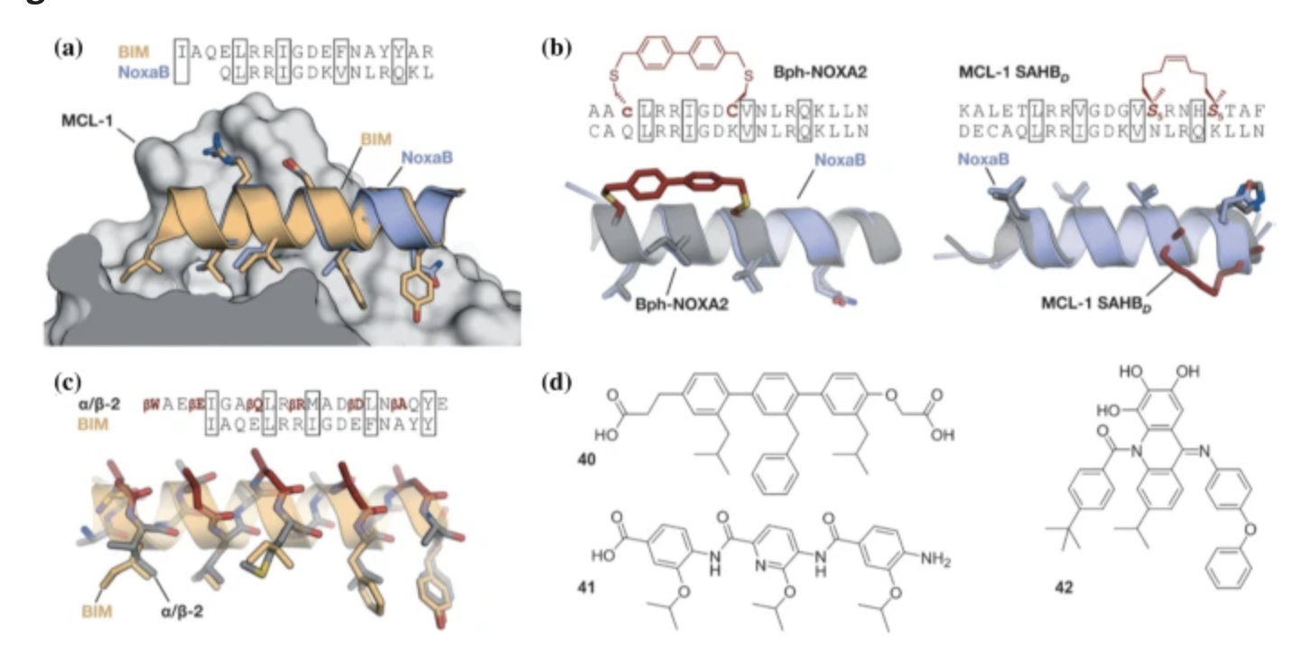
Peptide-based therapeutics
Peptidomimetics: A synthetic tool for inhibiting protein-protein interactions in cancer, Int J Pept Res and Ther, 2020

Slide 6
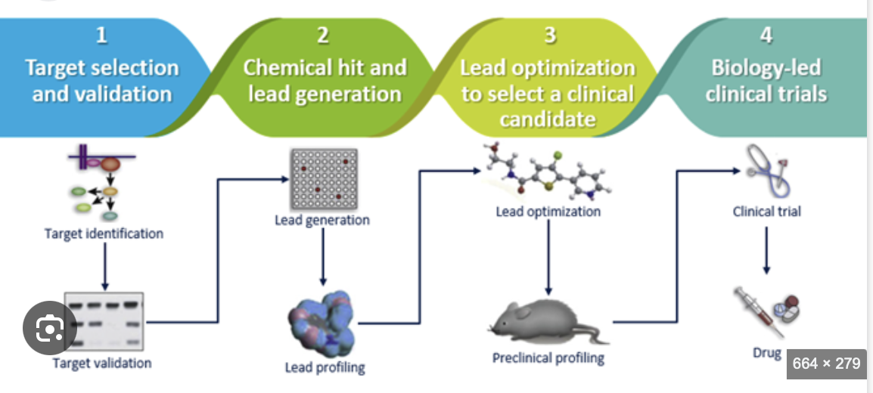
Small – molecule therapeutics
Google search image!

Slide 7
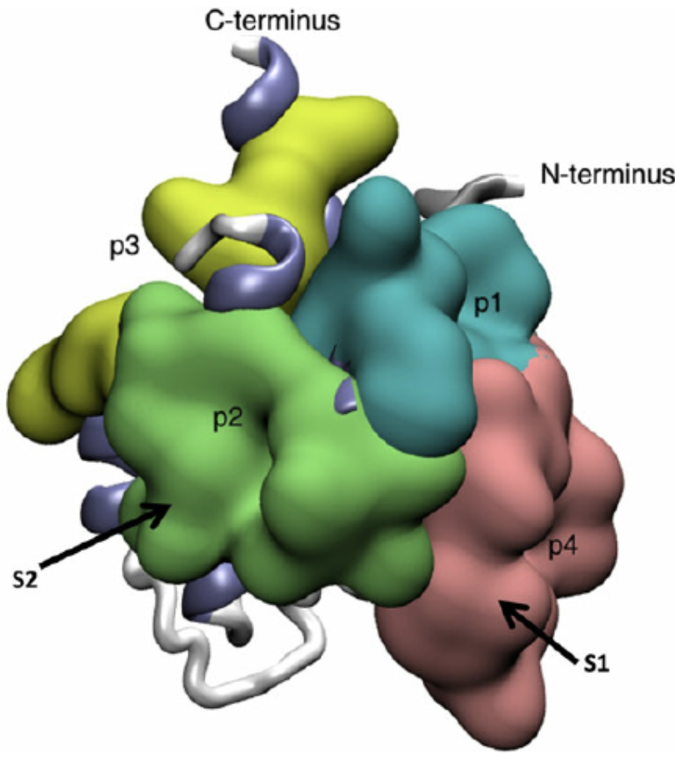
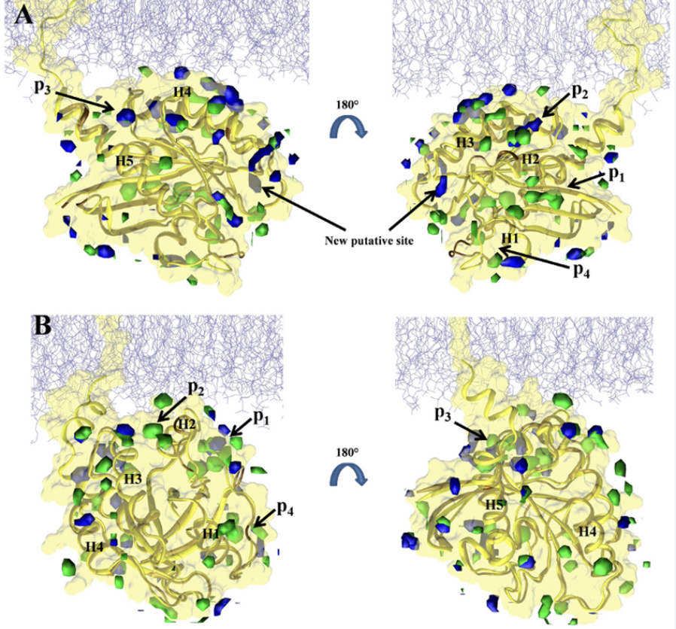
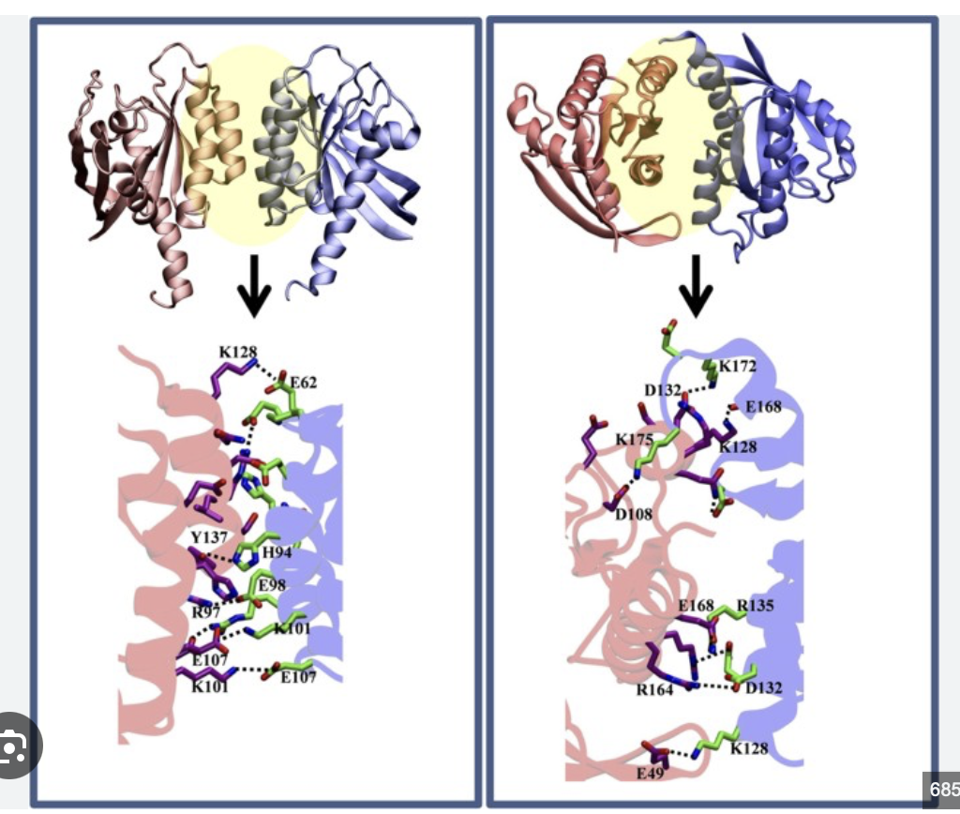
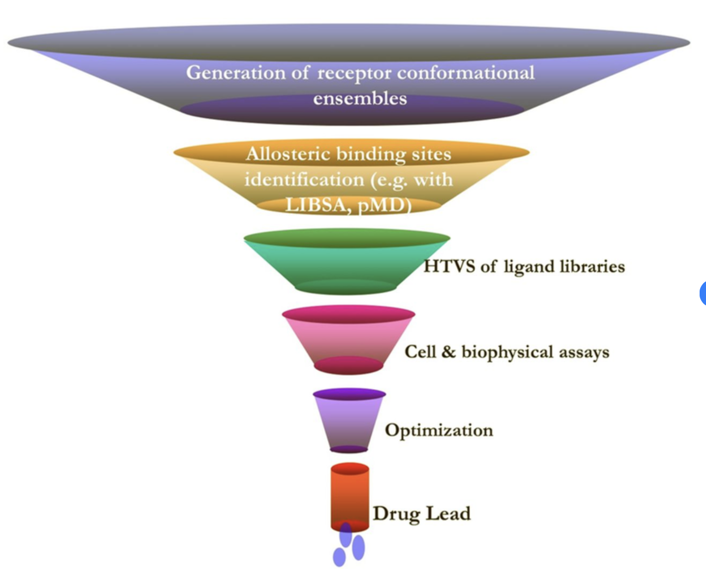
Computational simulations – drug discovery
https://www.linkedin.com/in/priyaps

Slide 8
Cheminformatics – drug discovery
Data Collection
Data Processing
Data Mining
Fingerprints/Graphs
Chemical descriptors
3D/2D encoding
Organic reaction
Compound library and database
Model generation
Property
Mining database
Analogues
Inspired by the following article:
Cheminformatics: An introductory review, Chonde and Kumara – conference contribution Penn State

Slide 9
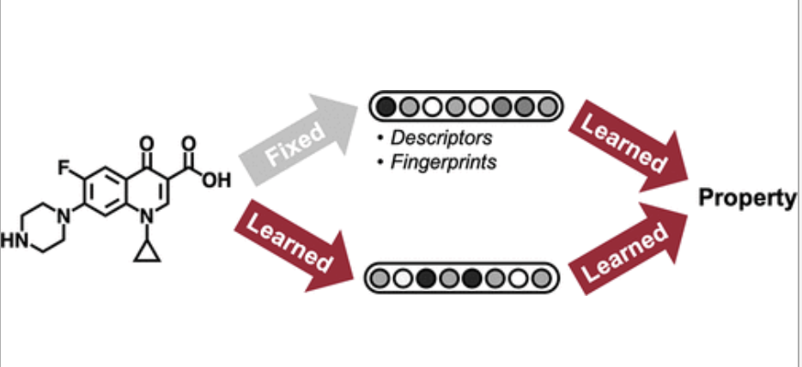
Deep learning in drug discovery: Chemprop
d-Message passing neural network (MPNN)
Original Article: Analyzing learned Molecular Representations for Property Prediction, Yang et al, JCIM 2019

Slide 10
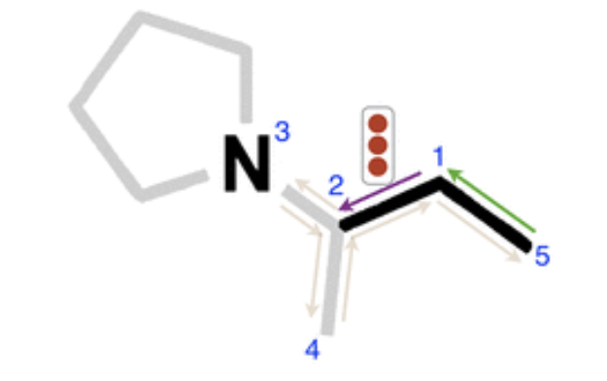
Chemprop – a directed MPNN
MPNN operates in two phases:
(1) a message passing phase – in the context of chemical structures it is transmitting information across the molecule to build a neural representation of the molecule
(2) a readout phase – This uses the final representation of the molecule for predictions
D-MPNN uses information associated with edges – accumulative type

Slide 11
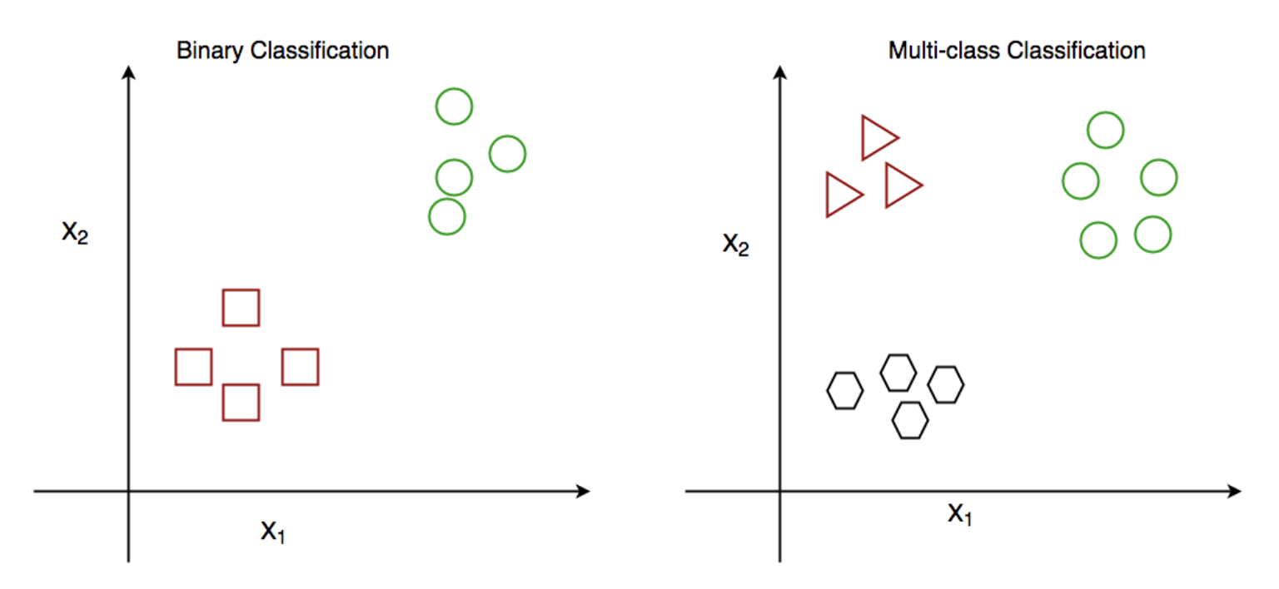
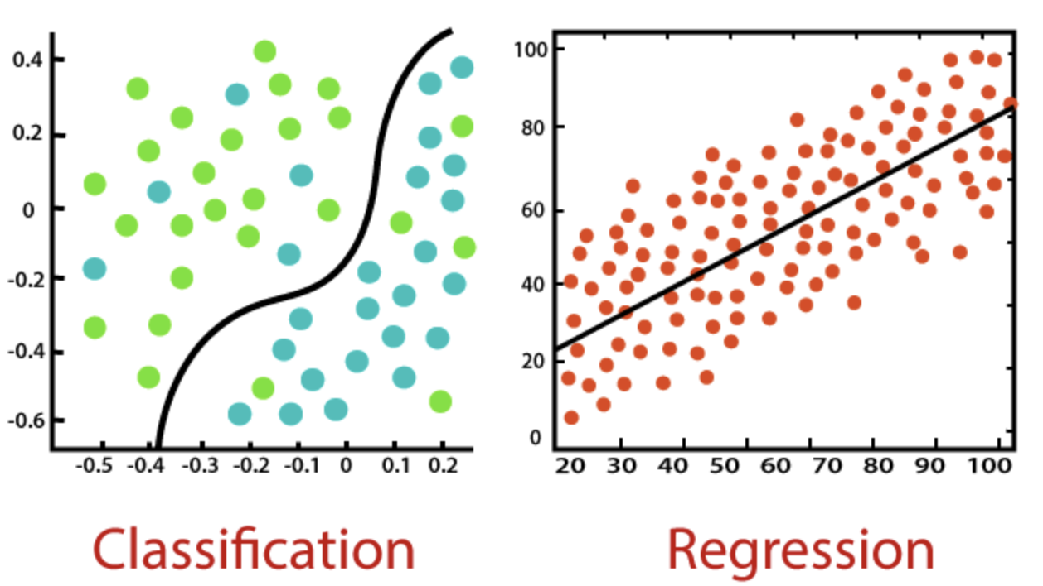
Classification/Regression in ML

Slide 12
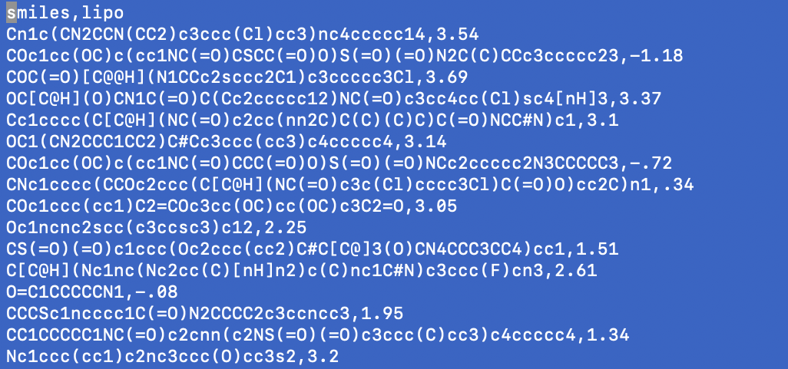
Regression example in drug discovery
Input is in CSV file format

Slide 13
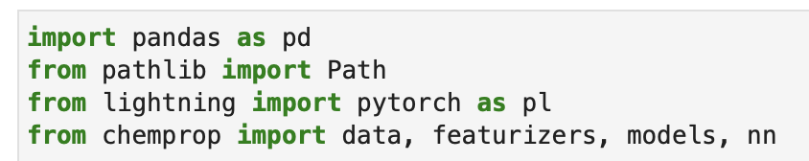
Regression example in drug discovery
Discuss the training example – Jupyter example

Slide 14
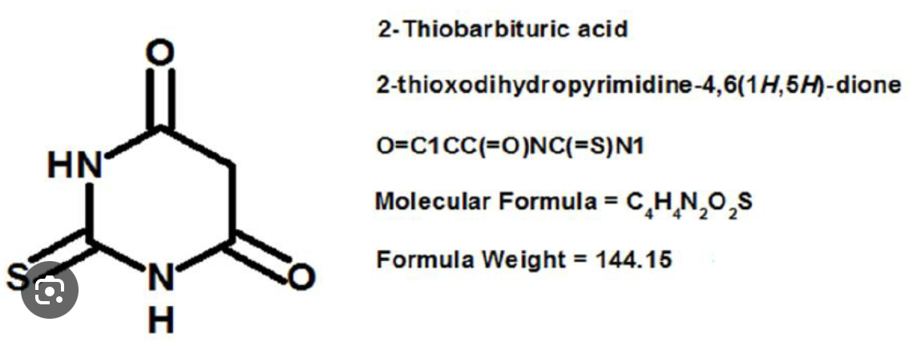
Smile format

Slide 15
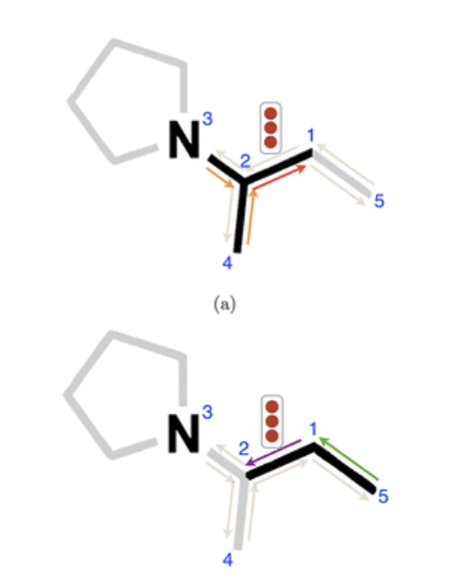
Featurization
Atom level information: atomic number, number of bonds for each atom, charge
Molecule level feature: type of bond, conjugation, ring membership
Other properties

Slide 16
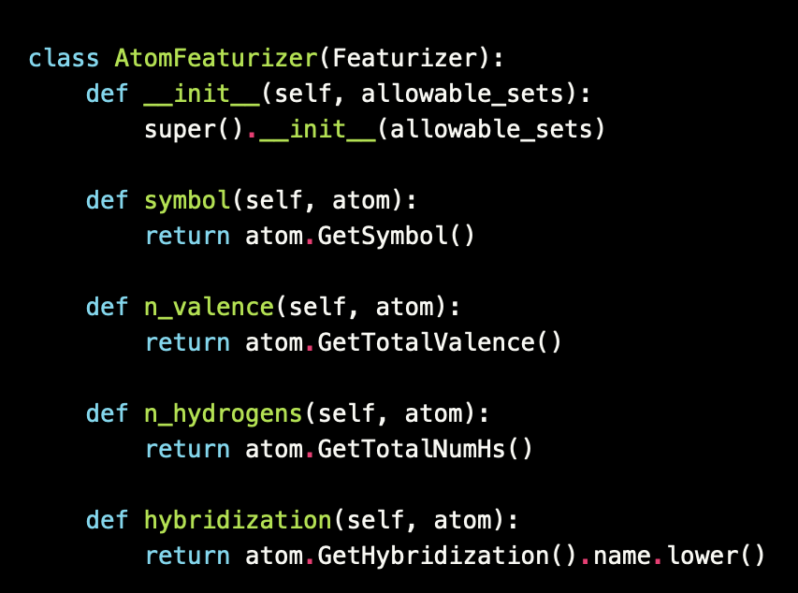
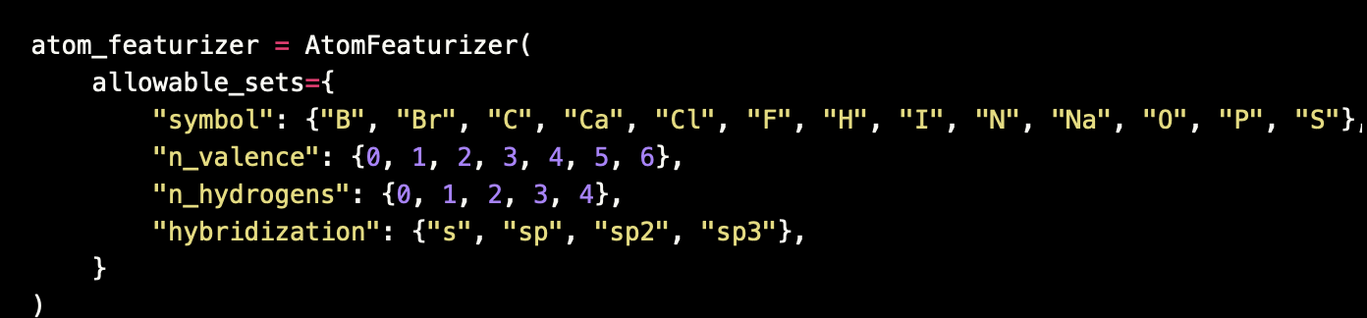
Featurization

Slide 17
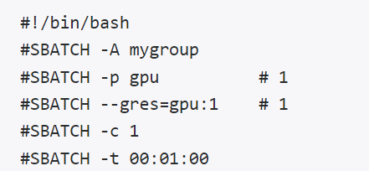
Chemprop using slurm script - train
Set Up Resources
-A: allocation
-p: partition
--gres=gpu:1 :use 1 gpu
-c: number of cores
-t: time limit
-J: job name
-o: standard output file (%A is the job #)
-e: standard error file (%A is the job #)
module purge
module load anaconda/2023.07-py3.11
conda activate chemprop
chemprop_train --data_path <input.csv> --dataset_type regression/classification --save_dir checkpoint --features_generator rdkit_2d_normalized --no_features_scaling

Slide 18
Chemprop using slurm script - predict
Set Up Resources
-A: allocation
-p: partition
--gres=gpu:1 :use 1 gpu
-c: number of cores
-t: time limit
-J: job name
-o: standard output file (%A is the job #)
-e: standard error file (%A is the job #)
module purge
module load anaconda/2023.07-py3.11
conda activate chemprop
chemprop_predict --test_path <test_set.csv> --checkpoint_dir checkpoint –prediction.csv

Slide 19
Chemprop using slurm script - interpret
Set Up Resources
-A: allocation
-p: partition
--gres=gpu:1 :use 1 gpu
-c: number of cores
-t: time limit
-J: job name
-o: standard output file (%A is the job #)
-e: standard error file (%A is the job #)
module purge
module load anaconda/2023.07-py3.11
conda activate chemprop
chemprop_interpret --data_path <input.csv> --checkpoint_dir checkpoint/location --property_id 1
"auc": [
0.7532467532467532 ]

Slide 20
Chemprop using slurm script – hyperparameter Opt
Set Up Resources
-A: allocation
-p: partition
--gres=gpu:1 :use 1 gpu
-c: number of cores
-t: time limit
-J: job name
-o: standard output file (%A is the job #)
-e: standard error file (%A is the job #)
module purge
module load anaconda/2023.07-py3.11
conda activate chemprop
chemprop_hyperopt --data_path <input.csv> --dataset_type regression/classification --num_iters 20 --config_save_path <path> --depth 5 --hidden_size 1600 --ffn_num_layers 1 --dropout 0.35 --epochs 30 --hyperopt_checkpoint_dir HYPEROPT_CHECKPOINT_DIR --num_folds 20

Slide 21
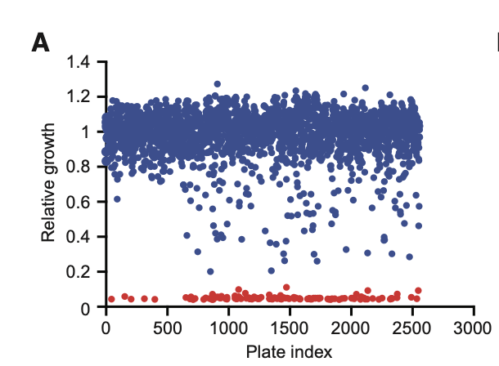
Application of Chemprop resulted in a novel antibiotic
A deep learning approach to antibiotic discovery, Stokes et al, Cell, 2020
US-FDA approved drug library containing 1760 molecules of diverse structure and function
800 natural products from plants, animals, and microbial sources
A total of 2,560 molecules tested for relative growth
Red = inhibitory action; Blue = non-inhibitory action
Deduplication resulted in 2,335 molecules
Small dataset hence learning is augmented by several features such as by including hundreds of molecular features, hyperparameter optimizations, ensembling

Slide 22
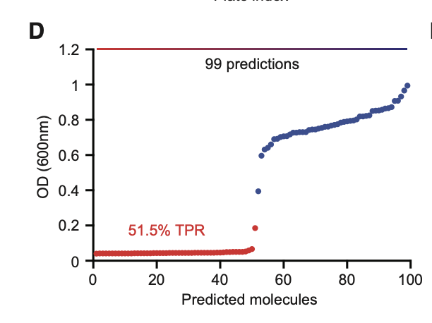
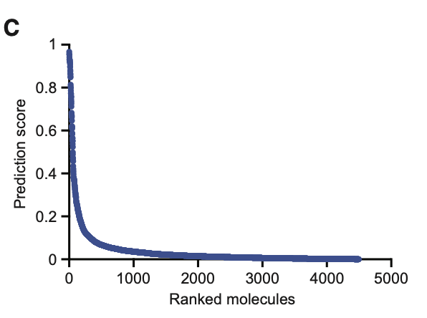
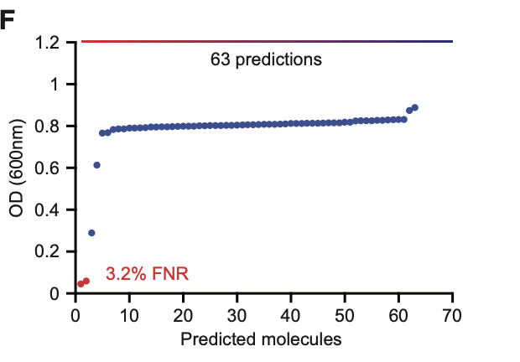
Model prediction in excellent agreement with experiments
The trained model is applied on the Drug Repurposing Hub
Positive correlation between growth inhibitory activity (red) and predicted D-MPNN derived ranking

Slide 23
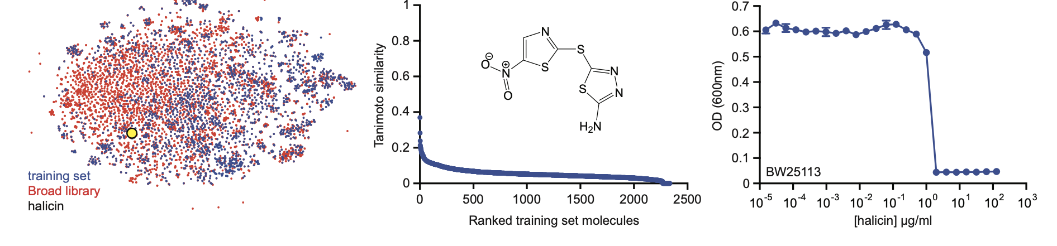
Halicin
Halicin is fished out by combining the tanimoto similarity with training set and clinical toxicity values with primary focus on lower toxicity and phase 1/2/3 study (Halicin shown as yellow circle)
Lowest similarity with training set is our primary target
Experiment shows Halicin’s low MIC value of 2 microgram/mL
Chemprop helped in the identification a potential new compound with antibiotic-like properties

Slide 24
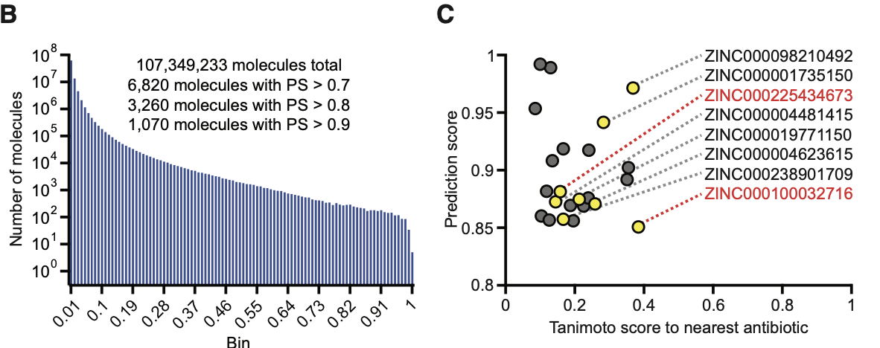
Screening billion compound library -- ZINC

Slide 25
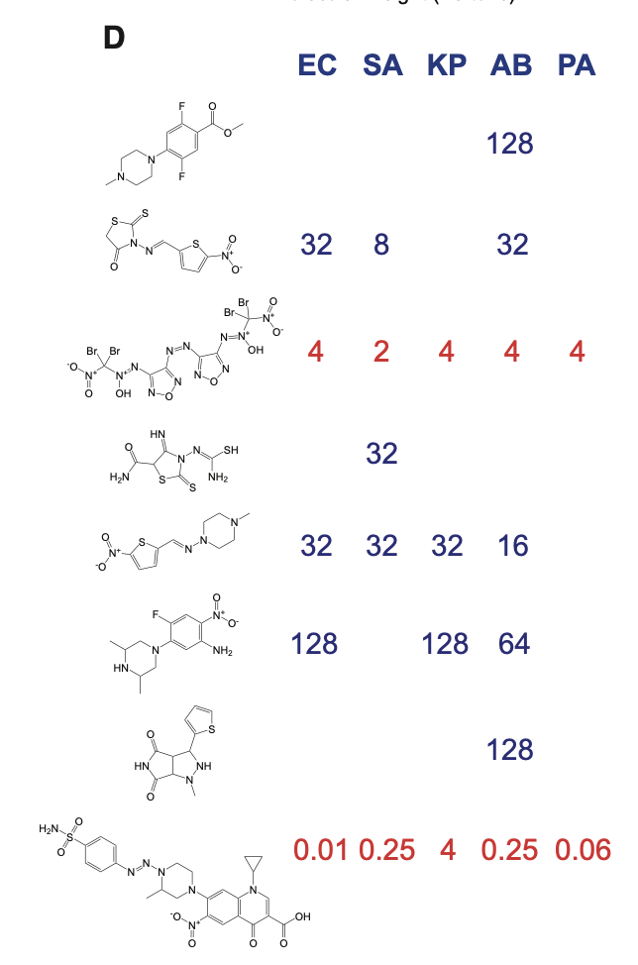
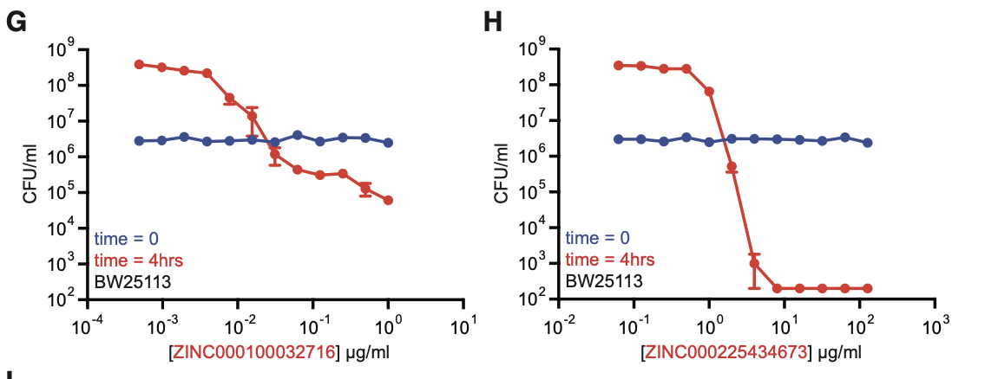
Two ZINC-derived compounds are promising
Chemprop helped in the identification a potential new compounds with antibiotic-like properties

Slide 26
Summary
Deep learning approach as applied in the field of small-molecule therapeutics
Application of the deep learning approach in the field of antibiotic drug discovery
HPC is required to harness the full power of deep-learning based programs

Slide 27

Data Analytics Center – Collaborations!
https://www.rc.virginia.edu/service/dac/

Slide 28
Need more help?
Workshop on Monday: 10th June: Introduction to Writing Slurm Job Scripts for HPC
Office Hours via Zoom
Tuesdays: 3 pm - 5 pm
Thursdays: 10 am - noon
Zoom Links are available at https://www.rc.virginia.edu/support/#office-hours
Website:
https://rc.virginia.edu

Slide 29
Thank you!! Questions?
https://virginia.az1.qualtrics.com/jfe/form/SV_7OtK8IEI2SEBQa2
Website:
https://rc.virginia.edu

